Slide 1
Extending Umbraco’s backoffice with custom editors
Leszek Porębski
leszek.porebski@intive.com
@lpsoft_pl
Warszawa, 26.05.2017

Slide 2
Agenda
Grid?
Grid Editors?
Custom Grid Editors?
But why…
Github link

Slide 3
Grid

Slide 4
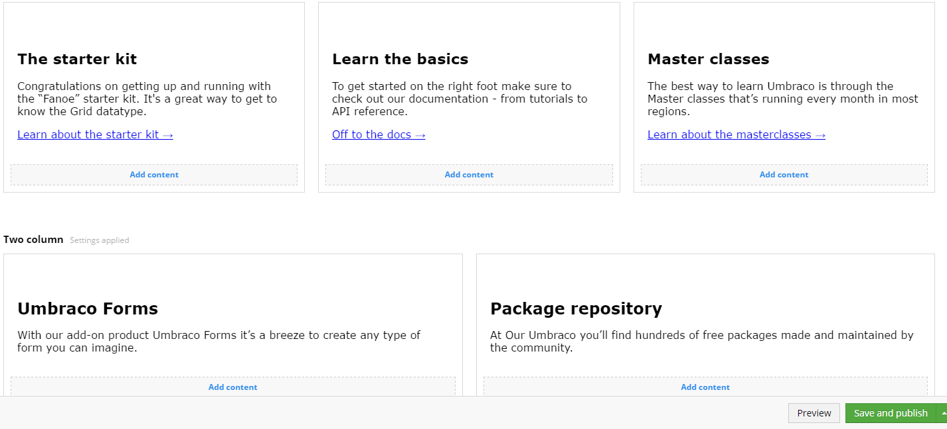
Grid

Slide 5
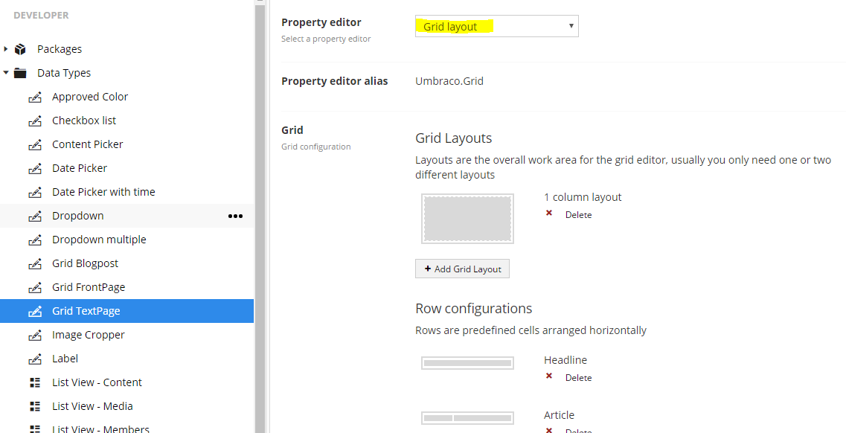
Grid
A property of some Data Type
A property editor of type „Grid layout”

Slide 6
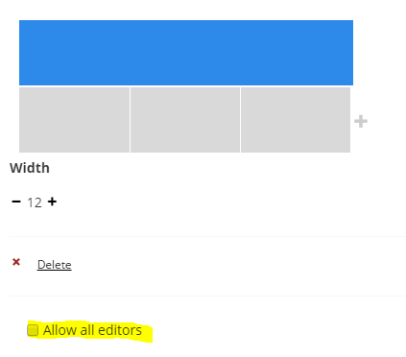
Grid
Grids can be customized in many ways…
RTE customization
Layouts definition
Rows definition
Cells customization

Slide 7
Grid Editors

Slide 8
Grid Editors
But before it, let’s see Grid configuration live…
Backoffice

Slide 9

Grid Editors
Ready to use controls for editing data

Slide 10
Grid Editors
Some fancy JavaScript
Configurable
/config/grid.editors.config.js
Extendable!

Slide 11
Grid Editors
Default editors:
RTE
Image
Macro
Embed
Headline
Quote

Slide 12
Custom Grid Editors

Slide 13

Custom Grid Editors
/config/grid.editors.config.js
Add new entry regarding your editor
Put you JS code somewhere in your project
Reference to your Grid Editors from this config file

Slide 14
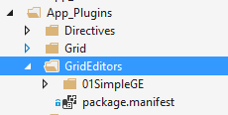
Custom Grid Editors
Put your code in /App_Plugins
Self-describe your plugin with package.manifest file
There’s a trap!
only one level deep manifests are discovered.
Notes:
Why this way?
It is easier to share plugins created this way

Slide 15
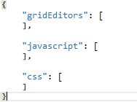
Custom Grid Editors
package.manifest
list of editors to register
list of referenced javascripts
list of referenced styles

Slide 16
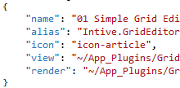
Custom Grid Editors
gridEditor definition
BackOffice display name
Internal alias
BackOffice icon
BackOffice View
EndUser View

Slide 17
Custom Grid Editors
Create a folder in App_Plugins
Make package.manifest file
Restart application so the plugins get rediscovered
Enable editors on elements of your choice

Slide 18
Let’s do this!

Slide 19

Custom Grid Editors
Renderer limitations/problems
Needs to inherit from Umbraco.Web.Mvc.UmbracoViewPage<dynamic>
No good place to store it except for the plugin’s directory
Cannot use partials (because of the dynamic type)
But there’s some hope!
We can still get around this problem by using helpers and strongly-typed models
We need to do it manually ☹

Slide 20
Custom Grid Editors
View’s pros
It’s an angular page
We have access to Bootstrap
View’s cons
It’s angular 1.1.5
It’s Bootstrap 2.3.1

Slide 21
Let’s do this!

Slide 22
Custom Grid Editors
How to access data?
$scope.control.value for grid editors
$scope.model.value for property editors
Bear in mind .value might and will be null at the beginning!

Slide 23
Custom Grid Editors
What can we use?
Umbraco provides you with UnderscoreJS
Don’t try to introduce Lodash in backoffice… it doesn’t turn out good ☹
What else can we do?
Well… it depends on our and our client’s imagination.
An editor is a regular angular’s controller
We can create modules, directives, constants etc.
Why struggle with ECMAScript 5? Use WebPack!

Slide 24
DEMO

Slide 25
Extending Rich Text Editor in Umbraco CMS
TinyMCE
TinyMCE in Umbraco CMS
Custom plugin for RTE
Demo

Slide 26
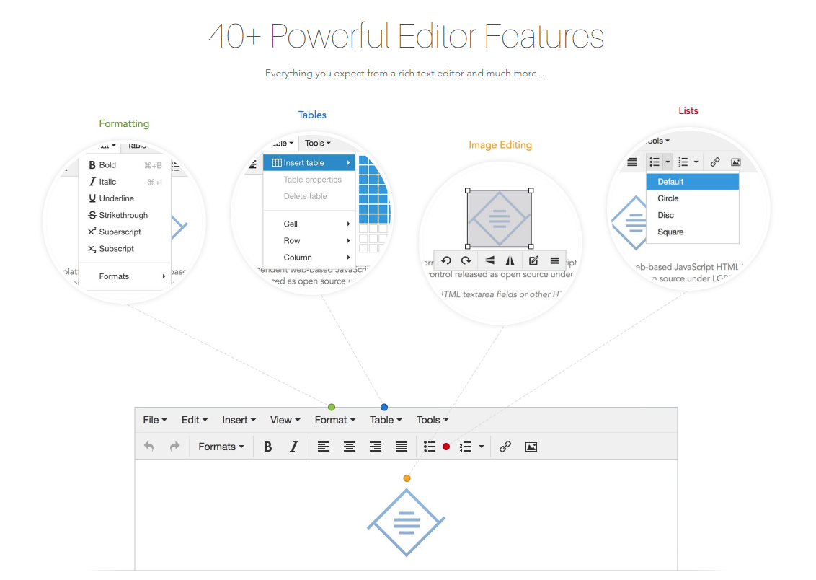
TinyMCE
Source: https://www.tinymce.com/features/

Slide 27
TinyMCE in Umbraco CMS
tinyMceConfig.config file
Be aware of Umbraco.PropertyEditors.RTEController parsing
Notes:
The configuration you set here will be used by each TinyMce instance as it is initialized in Umbraco.

Slide 28
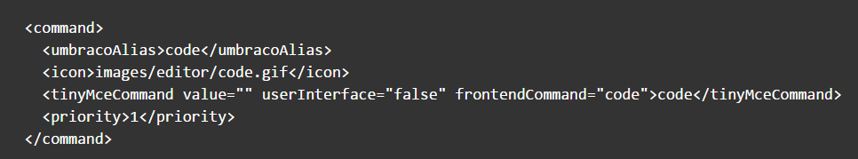
TinyMCE in Umbraco CMS – Commands
Source: https://our.umbraco.org/documentation/reference/config/tinymceconfig/
Notes:
Inside of the <commands> node you will find multiple <command> nodes. Each one of these nodes defines a icon/button that can appear on the formatting bar inside of Umbraco and the command that is triggered when it is clicked.
umbracoAlias defines a unique alias within Umbraco for the command. This alias should not contain any spaces.
icon defines the path to an image file to be used on the formatting toolbar. This image should be 16px x 16px in size.
tinyMceCommand defines the tinyMceCommand properties.
To further break this down, the value attribute is usually an empty value as most commands perform formatting tasks as opposed to returning values. The userInterface attribute takes a boolean value indicating whether or not the command has an additional UI component to display e.g. a new dialog to assist with inserting images. frontendCommand defines the name of the command to execute. This value usually matches the value of the tinyMceCommand node.
priority defines the sort order for the commands and should be sequentially incremented for each new command.

Slide 29
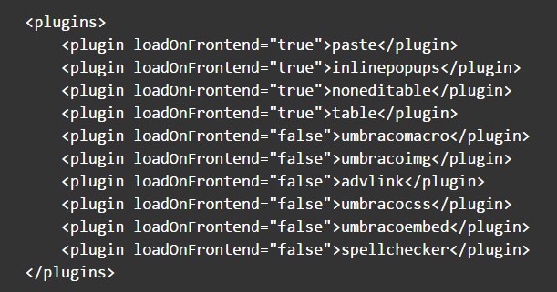
TinyMCE in Umbraco CMS – Plugins
Source: https://our.umbraco.org/documentation/reference/config/tinymceconfig/
Notes:
Inside of the <plugins> node you can find one or more <plugin> nodes. Each one of these nodes defines a plugin which extends the functionality of TinyMce. Below you will find the standard plugins configured in a clean install of Umbraco v6.x.

Slide 30
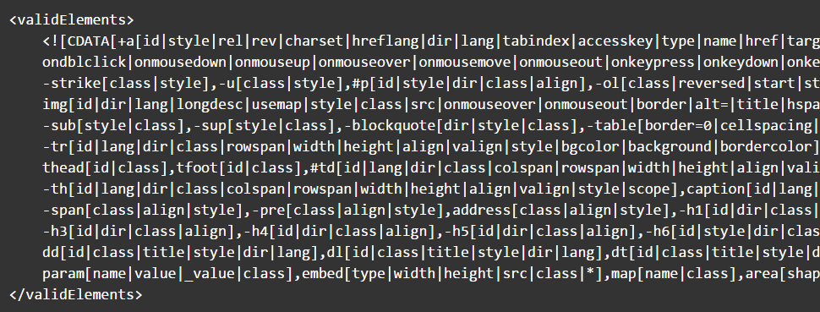
TinyMCE in Umbraco CMS – ValidElements
Source: https://our.umbraco.org/documentation/reference/config/tinymceconfig/
Notes:
The validElements node defines which elements will remain in the edited text when the TinyMce Rich Text Editor (RTE) saves. You can use this to limit the returned HTML to a subset.
This option contains a comma separated list of element conversion chunks. Each chunk contains information about how one element and its attributes should be treated.
Here is an example of the standard valid elements that come with a clean install of Umbraco v6.x.
control characters is taken from the official TinyMce documentation on the topic

Slide 31
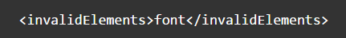
TinyMCE in Umbraco CMS – InvalidElements
Source: https://our.umbraco.org/documentation/reference/config/tinymceconfig/
Notes:
This option should contain a comma separated list of element names to exclude from the saved content. Elements in this list will be removed when your content is saved.

Slide 32
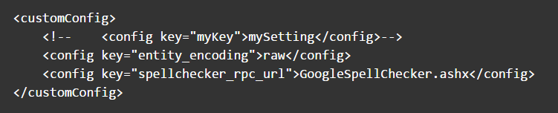
TinyMCE in Umbraco CMS – customConfig
Source: https://our.umbraco.org/documentation/reference/config/tinymceconfig/
Notes:
The customConfig node contains any custom configuration you would like applied to TinyMce when each instance is initialized. For examples of configuration options see the official TinyMce Configuration options documentation.

Slide 33
TinyMCE in Umbraco CMS – Custom Plugin
Add plugin.min.js \Umbraco\lib\tinymce\plugins\pluginname
Register command
Register plugin
Enable plugins in Umbraco Grid settings
Notes:
Gulp task to copy plugin to directory

Slide 34
TinyMCE in Umbraco CMS – Custom Plugin
tinymce core class
create() method
Editor class
dom – DOM instance for the editor
selection – Selection instance for the editor
execCommand()
Selection class
getNode()
Notes:
Create() - Creates a class, subclass or static singleton. More details on this method can be found in the Wiki.
Editor – this class contains the core logic for a TinyMCE editor.
dom - DOM instance for the editor.
execCommand() - Executes a command on the current instance. These commands can be TinyMCE internal commands prefixed with "mce" or they can be build in browser commands such as "Bold". A compleate list of browser commands is available on MSDN or Mozilla.org. This function will dispatch the execCommand function on each plugin, theme or the execcommand_callback option if none of these return true it will handle the command as a internal browser command.
Selection - This class handles text and control selection it's an crossbrowser utility class. Consult the TinyMCE Wiki API for more details and examples on how to use this class.

Slide 35
DEMO

Slide 36
Sources
https://www.tinymce.com
https://our.umbraco.org/documentation/reference/config/tinymceconfig/

Slide 37


Questions?
Grid?
Grid Editors?
Custom Grid Editors?
But why…
Github link
TinyMCE
TinyMCE in Umbraco CMS
Custom plugin for RTE
Demo

Slide 38
Thank You

